Slide 1

WEEKS 01-02
PROGRAMMING
FUNDAMENTALS
Introduction to Computers
and Programming
CS101 | BEGINNER LEVEL

Slide 2
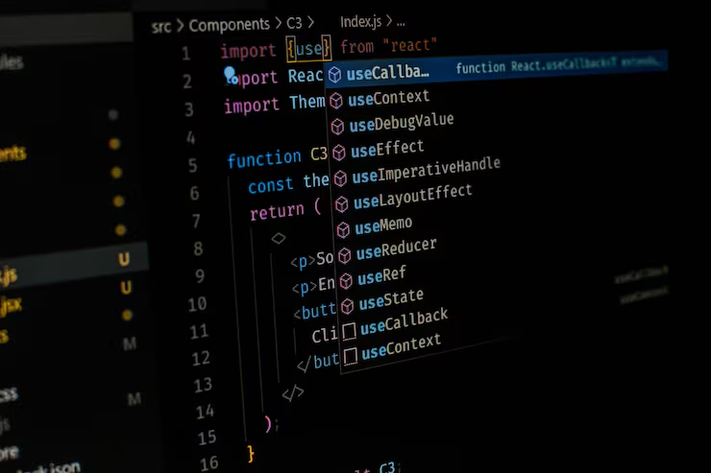
COURSE OVERVIEW
Contents
01 Why Program
02 Computer Systems: Hardware and Software
03 Programs and Programming Languages
04 What is a Program Made of?
05 Input, Processing, and Output
06 The Programming Process
07 Procedural and Object-Oriented Programming
02

Slide 3

01
WHY PROGRAM
Understanding the importance and purpose of computer programming in today's world

Slide 4
CHAPTER 01
What is Programming and Why Learn It?
Definition: Programming is the process of creating a set of instructions that tell a computer how to perform a task. It is the art of problem-solving using code.
Computers are everywhere — smartphones, cars, medical devices, appliances, and entertainment systems all run software.
Programming enables us to:
Automate repetitive tasks
Solve complex problems efficiently
Create new technologies and innovations
High demand for programmers across all industries with competitive salaries.
Programming teaches computational thinking:
Breaking problems into smaller steps
Logical reasoning and analysis
Systematic approach to solutions
Industry Insight: According to the U.S. Bureau of Labor Statistics, software developer jobs are projected to grow 25% from 2022 to 2032 — much faster than average.
04

Slide 5
CHAPTER 01
Real-World Applications of Programming
Mobile Apps
Web Development
Healthcare
iOS and Android apps for communication, mobile banking, health tracking, and social media.
E-commerce platforms, social media networks, streaming services, and online education portals.
Medical imaging software, patient management systems, and drug discovery algorithms.
Automotive
Entertainment
Science & Research
Self-driving systems, engine control units, GPS navigation, and vehicle diagnostics.
Video games, CGI effects in movies, music production software, and virtual reality.
Climate modeling, space exploration data analysis, and genome sequencing.
Everyday examples: digital calendars, GPS navigation, online banking, smart home devices
05

Slide 6
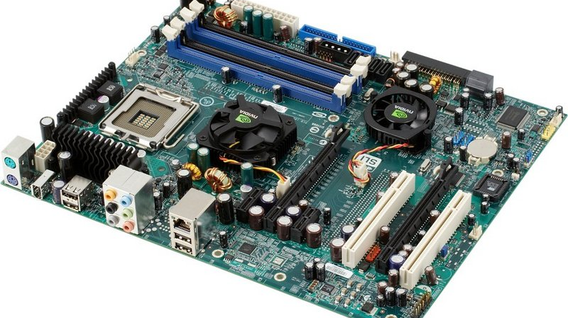
02
COMPUTER SYSTEMS
Hardware and Software — The building blocks of every computing system

Slide 7
CHAPTER 02
Computer Hardware Components
Hardware refers to the physical, tangible parts of a computer system that you can touch and see.
CPU (Processor)
RAM (Memory)
Storage Devices
The "brain" of the computer. Executes instructions and performs all calculations.
Temporary storage holding data and programs while running. Volatile — data lost when powered off.
Permanent storage: HDD and SSD. Holds files, programs, and data even when powered off.
Input Devices
Output Devices
Motherboard
Send data to the computer: keyboard, mouse, scanner, microphone, webcam.
Display results from the computer: monitor, printer, speakers.
The main circuit board connecting all hardware components together.
HARDWARE FLOW
Input Devices
CPU + RAM
Storage
Output Devices
07

Slide 8
CHAPTER 02
Computer Software Overview
Software is a collection of instructions (programs) and data that tells the computer how to perform specific tasks.
System Software
Application Software
Operating Systems (Windows, macOS, Linux) manage hardware resources and provide services for applications.
Programs for end-users: word processors, web browsers, games, spreadsheets, and mobile apps.
Utility Software
Programming Software
Tools that maintain and optimize system performance: antivirus, disk cleanup, backup tools, and file managers.
Tools for creating software: IDEs, compilers, debuggers, and text editors like VS Code and Eclipse.
Firmware
Software permanently stored in hardware devices (e.g., BIOS/UEFI in motherboards). It bridges hardware and system software.
08

Slide 9
CHAPTER 02
Hardware vs Software — Key Differences
Aspect | Hardware | Software
Nature | Physical, tangible components | Intangible instructions and data
Touch | Can be touched and seen | Cannot be touched
Creation | Manufactured in factories | Developed by programmers
Updates | Physical wear and tear | Updated without replacement
Analogy
Hardware is like the body (physical structure). Software is like the mind (instructions and thinking). Both work together: hardware provides the platform, software provides the instructions.
09

Slide 10
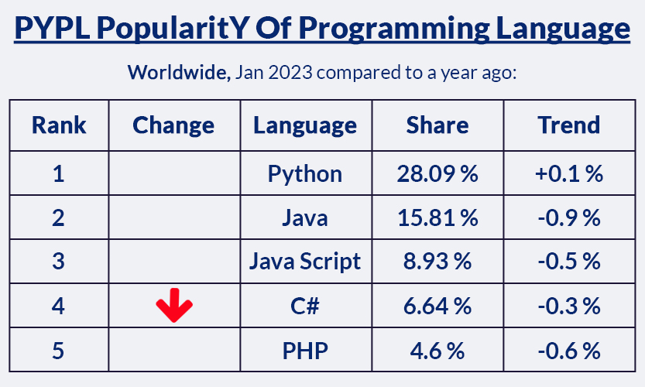
03
PROGRAMS AND PROGRAMMING
LANGUAGES
Understanding what programs are and the languages used to write them

Slide 11
CHAPTER 03
What is a Program?
Definition: A program is a sequence of instructions written in a programming language that a computer can execute to perform a specific task.
Programs solve problems by taking input, processing it, and producing output.
Every program follows a logical structure:
Sequential — instructions executed one after another
Conditional — instructions based on conditions
Loops — instructions repeated multiple times
Programs are stored as files and loaded into RAM when executed by the CPU.
Examples of Programs
■ Calculator app
■ Web browser
■ Video game
■ Word processor
■ Music player
■ Email client
■ Photo editor
A program can range from a few lines of code (simple script) to millions of lines (operating systems).
11

Slide 12
CHAPTER 03
Types of Programming Languages
Low-Level Languages
High-Level Languages
Machine Language
Closer to human language (English-like syntax). Easier to read, write, and maintain.
Require compilers or interpreters to translate into machine code.
Examples: Python, Java, C++, JavaScript, C#
The first high-level language was Fortran, developed in the 1950s by IBM.
Binary code (0s and 1s) directly understood by the CPU. Different for each processor type. Fastest execution but impossible for humans to read.
Assembly Language
Uses mnemonics (MOV, ADD, JMP) to represent machine instructions. Requires an assembler to translate into machine code.
TRANSLATION PROCESS
Source Code
Compiler / Interpreter
Machine Code
CPU Executes
12

Slide 13
CHAPTER 03
Popular Programming Languages Today
Python
Java
C / C++
Easy syntax, great for beginners. Used in data science, AI, web development, and automation.
"Write once, run anywhere." Used in enterprise apps, Android development, and large systems.
High performance. Used in game engines, operating systems, and embedded systems.
JavaScript
C#
Choosing Your First
The language of the web. Runs in browsers. Used for interactive websites and web applications.
Microsoft's language. Used for Windows apps, game development with Unity, and enterprise.
Consider your goals: Web (JS), Data Science (Python), Mobile (Java/Swift), Systems (C/C++)
Language Popularity (2023)
13

Slide 14
04
WHAT IS A PROGRAM
MADE OF?
The essential building blocks that form every program

Slide 15
CHAPTER 04
Program Building Blocks — Keywords, Operators, and Syntax
Keywords
Operators
Syntax
Reserved words with special meaning in a programming language.
Examples: if, else, while, for, return, class, int, void
Symbols that perform operations on data.
Arithmetic: +, -, *, /
Comparison: ==, !=, <, >
Logical: AND, OR, NOT
The set of rules defining how programs must be written.
Like grammar in a natural language. Breaking syntax rules causes errors.
Code Example
// Calculate the area of a rectangle
int length = 10; // variable declaration (Keyword + Identifier)
int width = 5;
int area = length * width; // arithmetic operation (Operator)
System.out.println("Area: " + area); // output statement
15

Slide 16
CHAPTER 04
Program Organization — Variables, Data Types, and Control
Variables and Data Types
Control Structures
Variables are named storage locations that hold data values.
Data Types:
Integer — whole numbers: 42, -7, 0
Float/Double — decimals: 3.14, -0.5
String — text: "Hello!"
Boolean — true or false
Direct the flow of program execution:
Sequence — Execute statements in order (top to bottom)
Selection — if-else: execute code based on conditions
Iteration — for, while: repeat code multiple times
Control Flow Diagram
Sequence
Step A → Step B → Step C
Selection
if (condition) then...
Iteration
while (condition) loop
Execute in order
Make decisions
Repeat actions
Functions / Methods
Reusable blocks of code that perform a specific task. They help organize code, reduce repetition, and make programs easier to maintain.
16

Slide 17

05
INPUT, PROCESSING,
AND OUTPUT
The fundamental model that all programs follow

Slide 18
CHAPTER 05
The IPO Model — Input, Process, Output
The IPO Model is the fundamental pattern that all computer programs follow.
INPUT
PROCESS
OUTPUT
Data from keyboard, mouse, file, sensor, network
Calculations, comparisons, logical operations
Results on screen, printer, file, speaker
Analogy: Like a factory — raw materials → manufacturing → finished product
Example — Calculator Program
INPUT
User enters two numbers:
5 and 3
Selects operation: +
PROCESS
Program performs
the calculation:
5 + 3 = 8
OUTPUT
Program displays
the result on screen:
Result: 8
18

Slide 19
CHAPTER 05
IPO Examples in Everyday Programs
ATM Withdrawal
Google Search
Temperature Converter
Input: ATM card + PIN + amount ($100)
Process: Verify balance, deduct amount
Output: Cash + receipt + updated balance
Input: Search query ("best pizza near me")
Process: Algorithm ranks web pages
Output: List of search results
Input: Temperature value (32°F)
Process: Apply formula (°F-32) x 5/9
Output: Display result (0°C)
Key Insight: Every program, no matter how complex, follows the same IPO pattern. Understanding this model helps you design and analyze any program.
Generalized IPO Pattern
Get Input
from user/device/file
Process Data
calculate/transform
Produce Output
display/save/send
19

Slide 20
06
THE PROGRAMMING
PROCESS
From problem to solution — the systematic approach to writing programs

Slide 21
CHAPTER 06
Steps in the Programming Process
1
Define the Problem
Clearly understand what the program needs to accomplish; identify inputs, processes, and expected outputs.
2
Plan the Solution
Create an algorithm (step-by-step procedure); use pseudocode or flowcharts to outline the logic.
3
Write the Code
Translate the algorithm into a programming language; follow syntax rules and best practices.
4
Test and Debug
Run the program with test data; find and fix errors (bugs); verify output is correct.
5
Document and Maintain
Add comments and documentation; update the program as requirements change.
The Iterative Cycle
DEFINE
PLAN
CODE
TEST
This cycle is iterative — you often return to earlier steps as you discover issues or new requirements.
21

Slide 22
CHAPTER 06
Understanding Errors — Syntax, Logic, and Runtime
Syntax Errors
Logic Errors
Runtime Errors
Violations of the language rules. Caught by the compiler before execution.
Examples:
Missing semicolon
Unmatched parentheses
Misspelled keywords
Easy to find — the system tells you where they are.
The program runs but produces incorrect results. The algorithm is flawed.
Examples:
Using + instead of *
Wrong if-condition
Incorrect formula
Harder to find — requires careful testing.
Occur while the program is running. Cause the program to crash.
Examples:
Division by zero
File not found
Out of memory
Handled with error-checking code.
Debugging Tips
Read error messages carefully | Use print statements to trace values | Test with simple inputs first | Check one section at a time | Take breaks — fresh eyes catch bugs faster
22

Slide 23
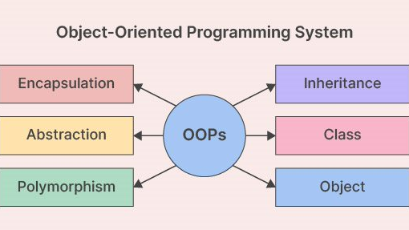
07
PROCEDURAL AND
OBJECT-ORIENTED PROGRAMMING
Two fundamental approaches to organizing and structuring code

Slide 24
CHAPTER 07
Procedural Programming — Step-by-Step
Definition: A programming paradigm where the program is structured as a sequence of procedures (functions) that operate on data.
Key Characteristics
Languages & Use Cases
Programs organized around functions/procedures
Data and functions are separate
Data passed between functions as parameters
Code executes in top-down manner
Emphasizes logical sequence of actions
Languages: C, Pascal, Fortran, BASIC
Best for:
Simple, straightforward tasks
Smaller programs and scripts
System utilities
Performance-critical code
Analogy
Following a recipe — Step 1, Step 2, Step 3... each step is a procedure executed in order.
24

Slide 25
CHAPTER 07
Object-Oriented Programming — Objects and Classes
Definition: A paradigm that organizes code around "objects" — self-contained units combining data and the functions that operate on that data.
Class
Object
Encapsulation
A blueprint/template defining what an object will contain — its data and functions.
An instance of a class. A concrete entity created from the blueprint.
Bundling data and methods together. Hiding internal details from the outside.
Inheritance
Polymorphism
Creating new classes based on existing ones. Reusing and extending code without rewriting it.
Same method name behaves differently depending on the object. One interface, multiple implementations.
Languages: Java, C++, Python, C#, JavaScript | Best for: Large complex applications, code reuse, modeling real-world entities
Analogy: A car factory — Class = car blueprint, Object = each individual car produced
25

Slide 26
CHAPTER 07
Procedural vs Object-Oriented — Comparison
Aspect | Procedural | Object-Oriented
Organization | Functions and procedures | Objects (data + methods)
Data Handling | Data is separate, passed as parameters | Data encapsulated within objects
Code Reuse | Limited, through functions | Strong, through inheritance
Security | Data is exposed | Data can be hidden (private)
Best For | Small-medium programs, scripts | Large applications, complex systems
Key Insight
Modern programs often use a mix of both approaches. Neither is "better" — the choice depends on the problem, team, and project size. Many languages (Python, C++) support both paradigms.
26

Slide 27
WEEKS 01-02 SUMMARY
KEY TAKEAWAYS
01 Programming is giving computers instructions to solve problems
02 Hardware provides the physical platform; Software provides instructions
"Practice is the key to becoming a skilled programmer."
Start coding today!
03 Programs follow the Input → Process → Output model
04 The programming process: Define → Plan → Code → Test → Maintain
05 Two main paradigms: Procedural and Object-Oriented
PROGRAMMING FUNDAMENTALS | CS101
THANK YOU

